Slide 1

Weather Prediction Modelling for sensor placement
Contributors: Jeremy Cryer, Alec Anderson
University of San Diego: AAI-510
Professor: Som Shahapurkar
June 26, 2023

Slide 2

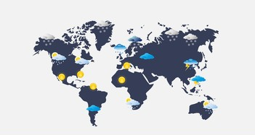
Problem Statement and Impact
A research lab is attempting to predict sudden changes in worldwide climate conditions. This is needed to assist in identifying when possible natural disasters may occur by knowing when sudden changes in weather occur and knowing when the normal situations shift.
GOAL: Create a way to predict normal trends based on historical data to understand what the normal is.
Impact and Need
Society Awareness
Danger Prevention
Increased Knowledge in Standard Weather Patterns.

Slide 3
Possible Solution options

Slide 4
Final Recommendation

Slide 5
The Risks Involved
Operational
Ethical
Regulatory

Slide 6
Mitigation Stratgy

